Slide 1
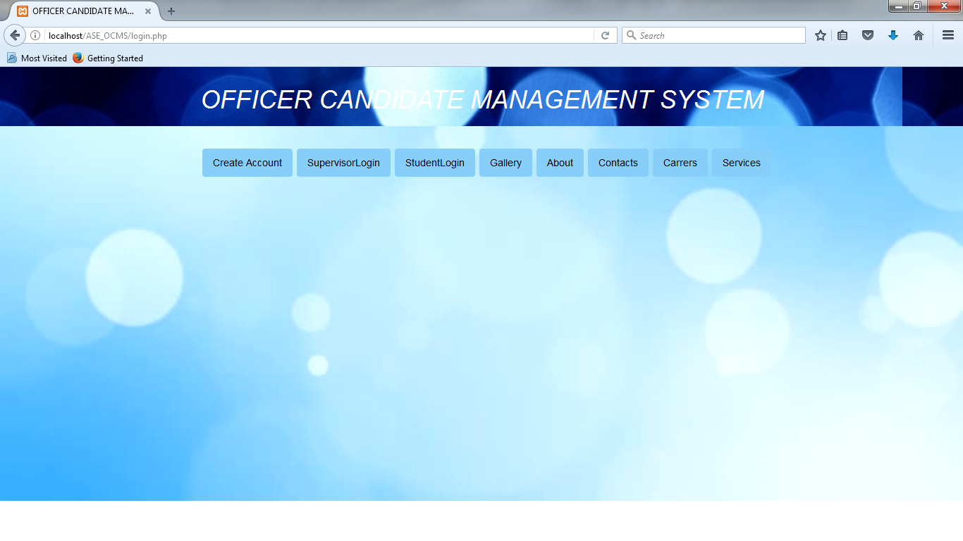

“OFFICER CANDIDATE MANAGEMENT SYSTEM 2.0”
Team Member(s): Hansini Seth, Ishan Shrivastava Product Owner: Tiago Moore
Instructor: Masoud Sadjadi and Francisco R. Ortega School of Computing and Information Sciences Florida International University
Final Presentation
Spring 2017
Notes:
7 seconds.
Greet your audience, thank them for attending your presentation, introduce yourself, introduce your project, introduce your team members, and quickly indicate what each of you did in a high-level manner, and put more emphasis on your part/contribution.

Slide 2
Project definition
OCMS is an unique application which will allow officers and evaluating personnel to efficiently manage, rank, and evaluate new cadets and officer candidates in training. This tool will reduce the amount of paperwork done on a daily basis, and will allow for a smooth experience for students training as officer candidates. This application will allow supervisor to track students progress throughout the training period.
Notes:
10 seconds.
Introduce the problem that the whole project (in all versions) tackles with GIF or screenshot.

Slide 3
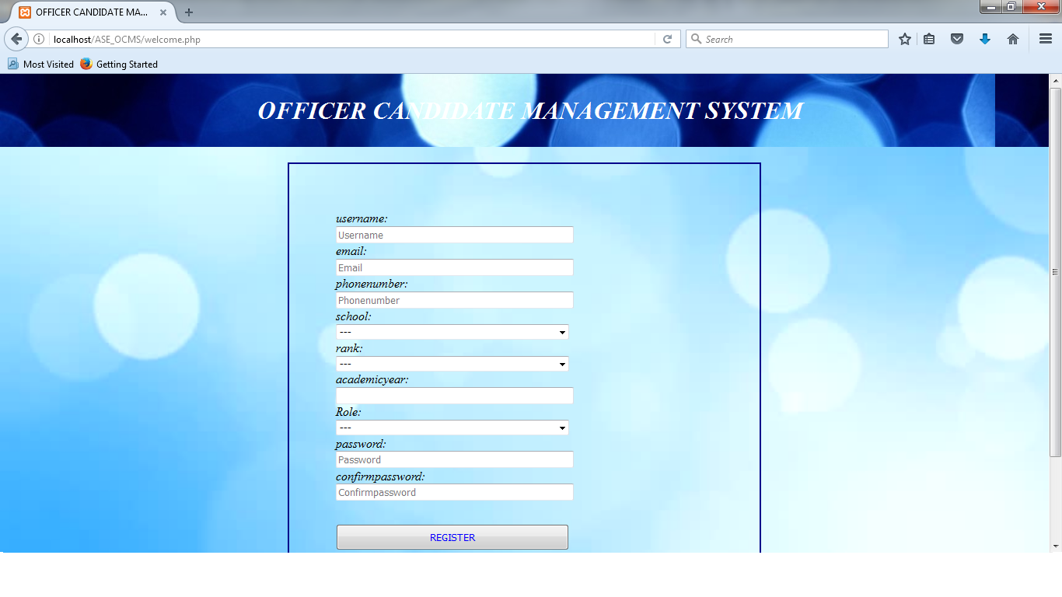
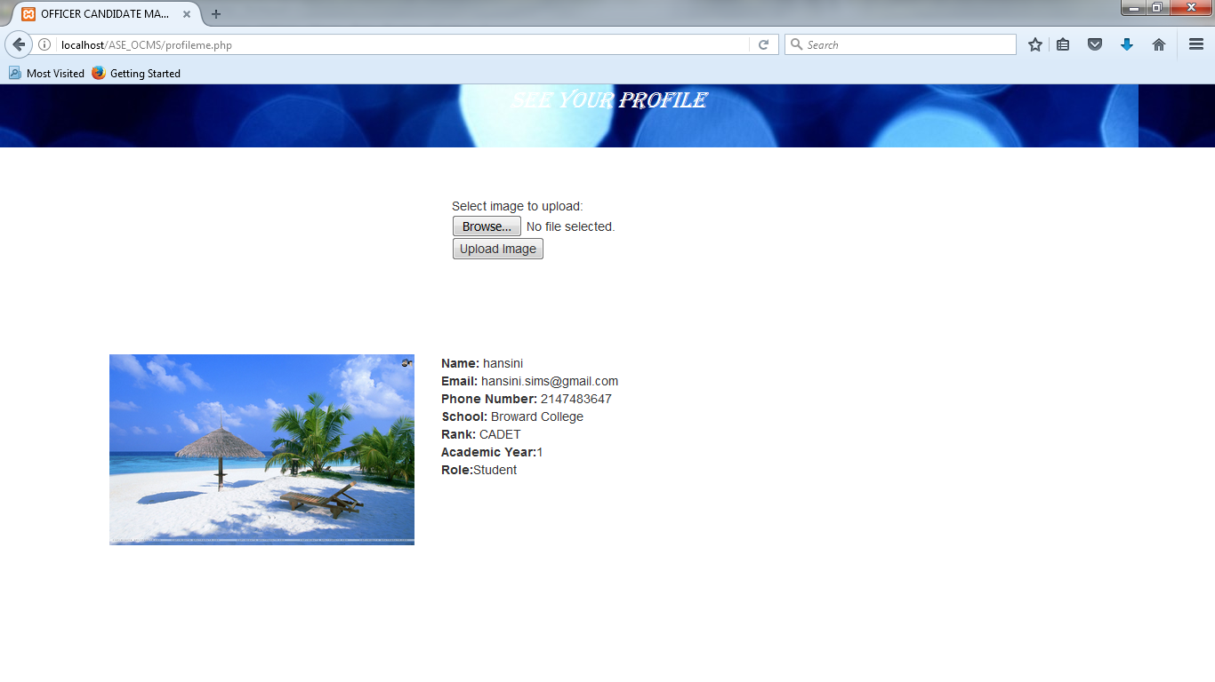
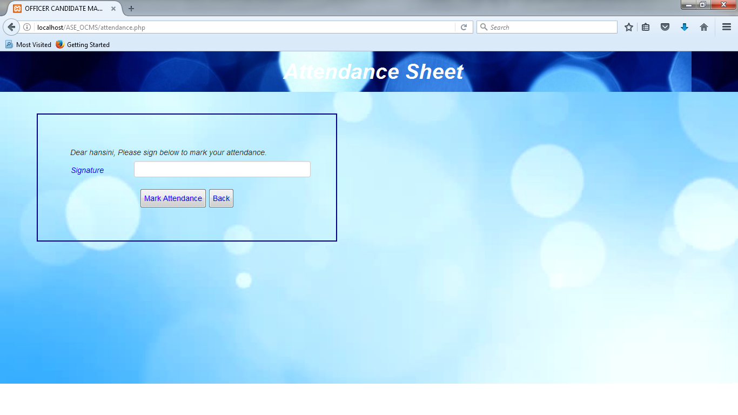
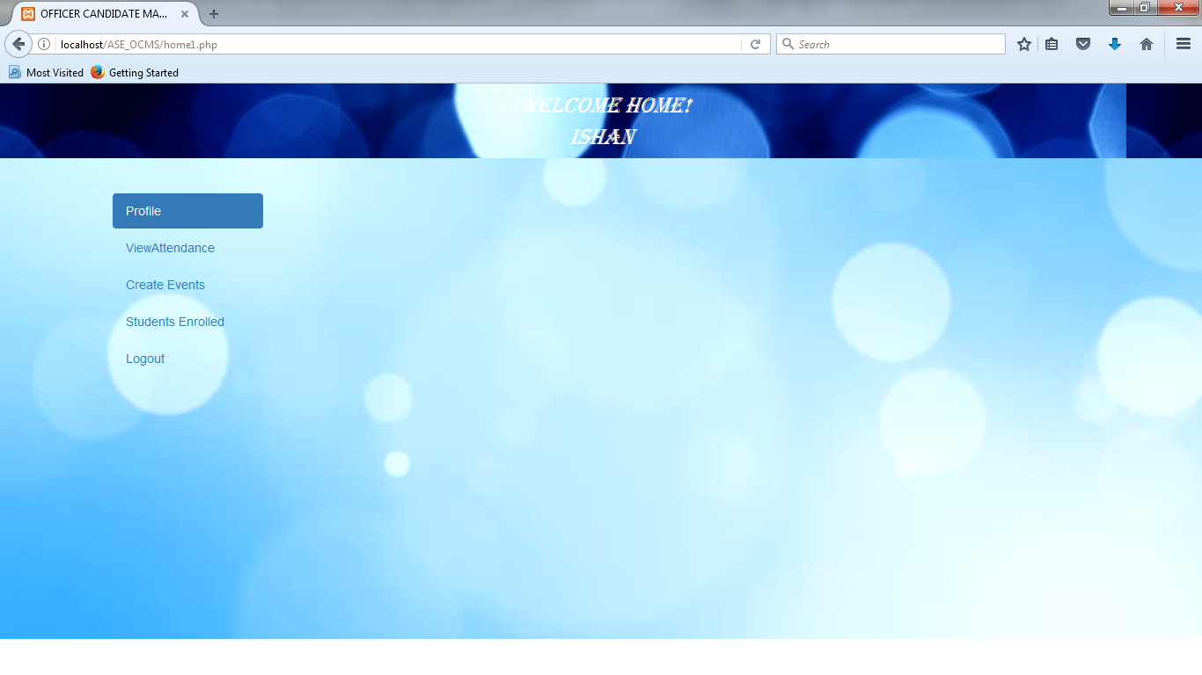
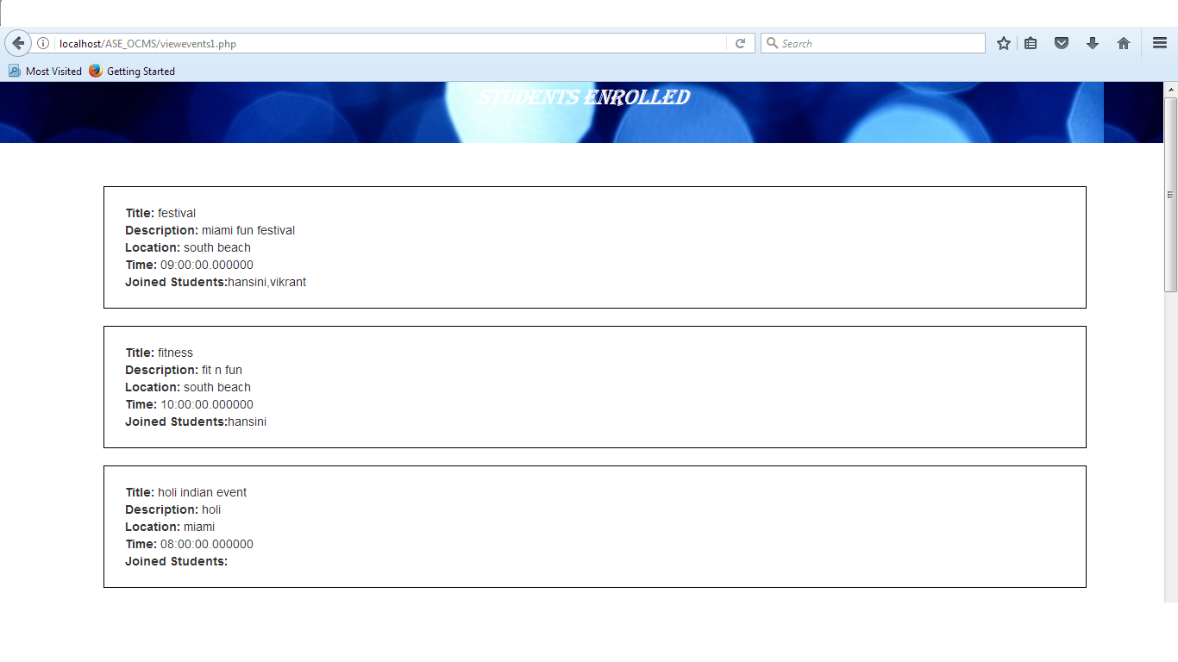
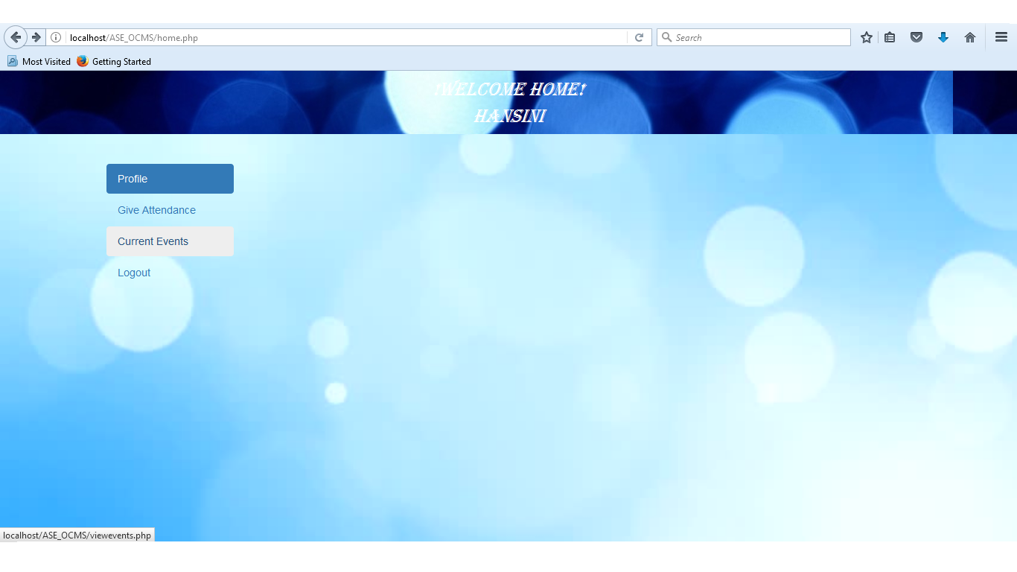
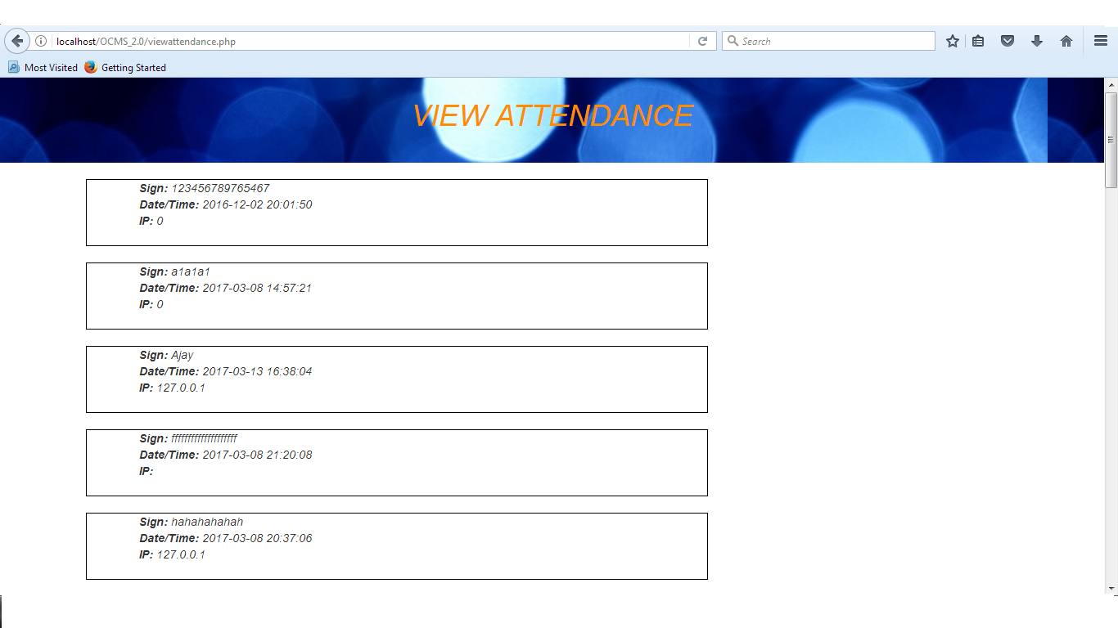

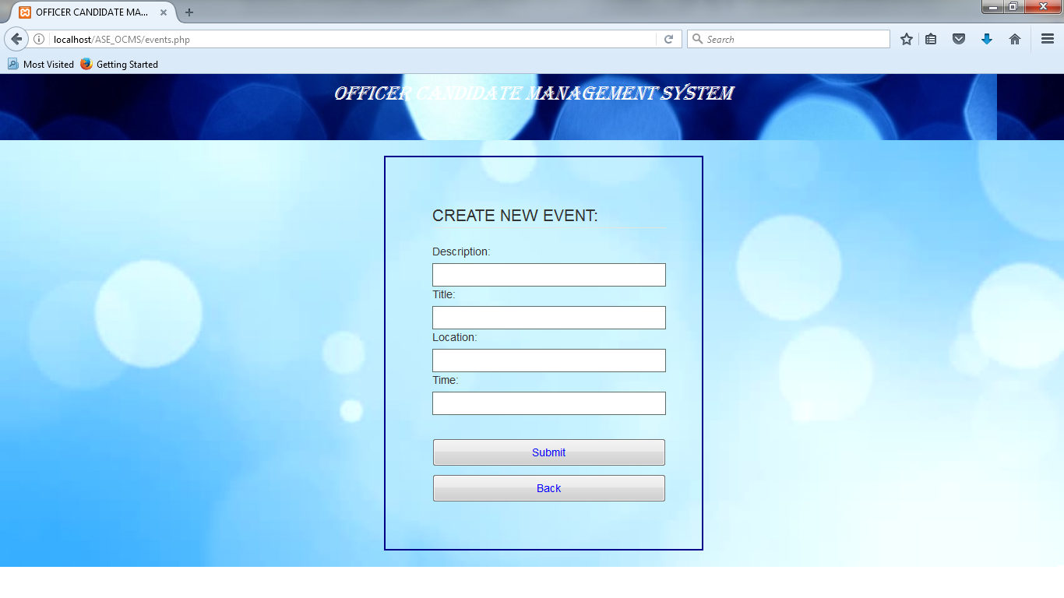
Notes:
20 seconds.
Introduce the problem that the your project (in new version) tackles with GIF or screenshot.

Slide 4
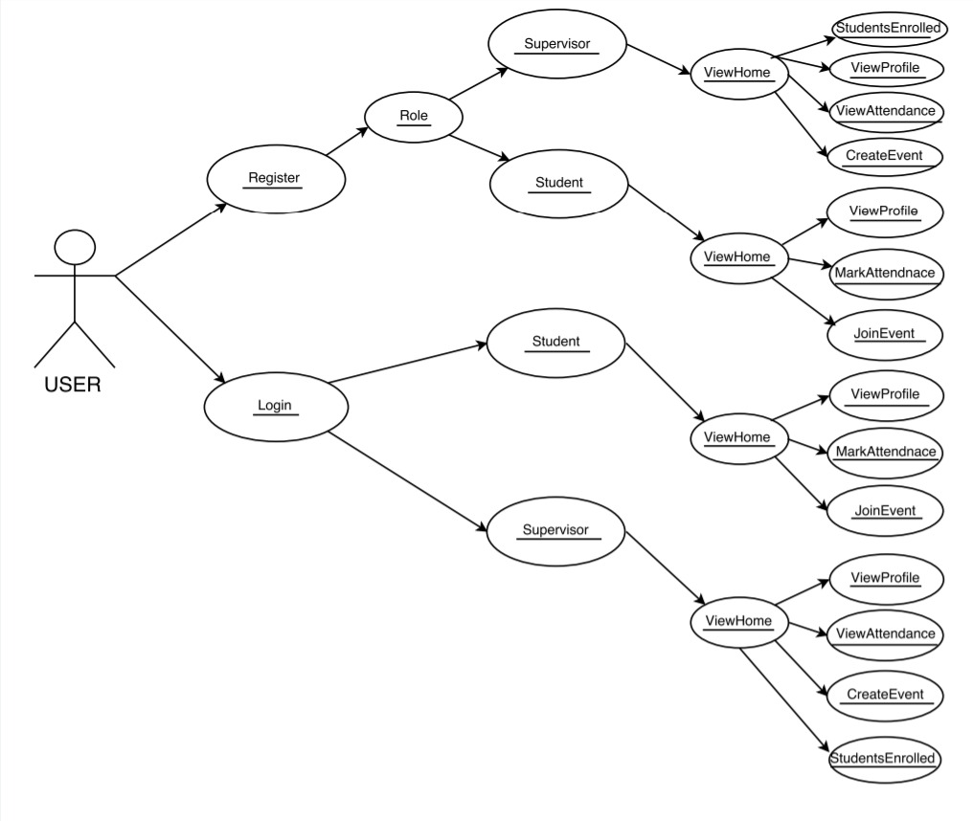
Requirements: Use Cases
Notes:
5 seconds
Show the Use Case Diagram for the whole project. Highlight your use cases.

Slide 5
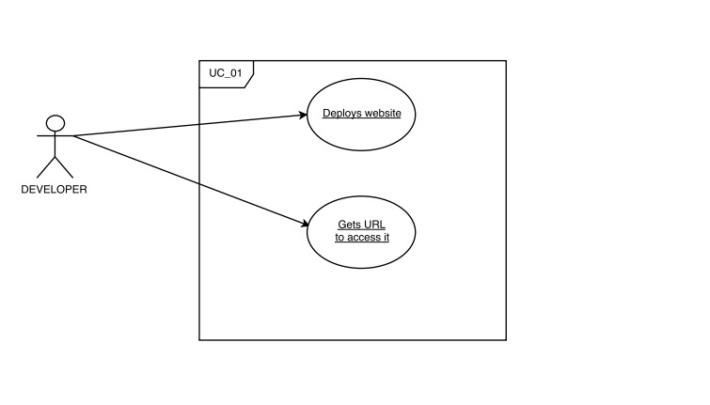

Slide 6
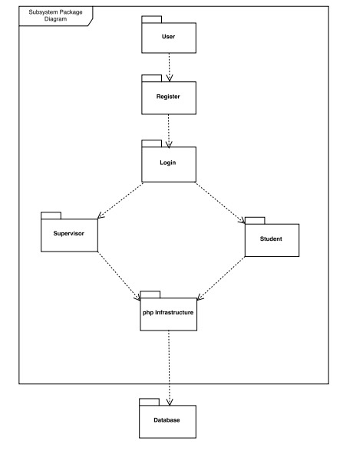
System Design: System decomposition
Notes:
20 seconds
System design: Highlight the parts that you contributed to them.
1. System decomposition; identify the architecture patterns used
2. System deployment – h/w and s/w requirements

Slide 7
System Design: System Deployment
Windows Computer.
Software Stack: PHP, Phpmyadmin(MySQL), Windows, XAMPP.
Desired compatible hardware devices.
Amazon Web Services.

Slide 8
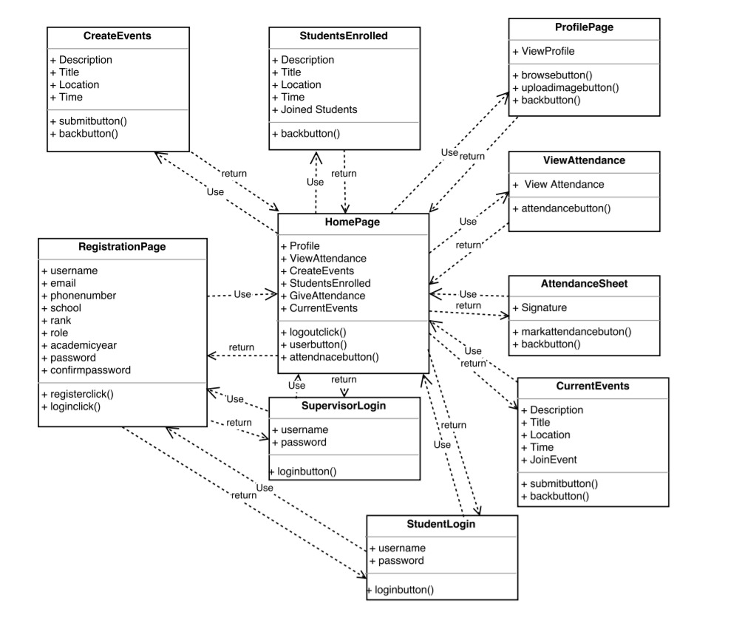
Minimal Class Diagram
Notes:
10 seconds. Minimal class diagram. Highlight the classes that you created/modified
Identify the design patterns used (one or more slides).

Slide 9
User Stories
As a Student/Supervisor, I would like to register and login to the system so that I can enter into the system and can view my account.
As a Student/Supervisor, I would like to view my profile retrieved from the databases and upload a picture, so that I can see it on my profile page.
As a Student, I would like to mark my attendance with name, date, time and IP address, so that the supervisor would know that I was present during the training.
As a Supervisor, I would like to view the attendance with name, date, time and IP address of the students who were present so that I know who all attend the training.
As a Supervisor, I would like to create new events so that the students can view and join the events . Also I would like to view the list of students enrolled in the event.
As a Student, I would like to view the events and join them, so that the supervisor will know that I have joined the particular event.
Notes:
5 seconds.
List the user stories that you worked on them.(put in order of importance). Stay focused on the parts that you have been working.

Slide 10
User Story #1
As a Student/Supervisor, I would like to register and login to the system so that I can enter into the system and can view my account.
Student/Supervisor has to enter some credentials which are mandatory so that they can register into the system.
With username and password, both student and supervisor can login and view their home page.
Notes:
60 seconds
The tile of user story
The most important user story you worked on it. You have to describe this one very well and be proud of that.
Please present and show the complexity of your work, code, algorithms, and technical challenges and technologies you have used. (you could use screenshot if you want. Visual presentations are better than text presentation)
Go into the details of the most important/significant tasks using bullet lists or visual graphs or state chart diagram
Sequence Diagram for this user story is mandatory (in another separate page if required)
Demo using screenshots or GIF (in another separate page if required)

Slide 11
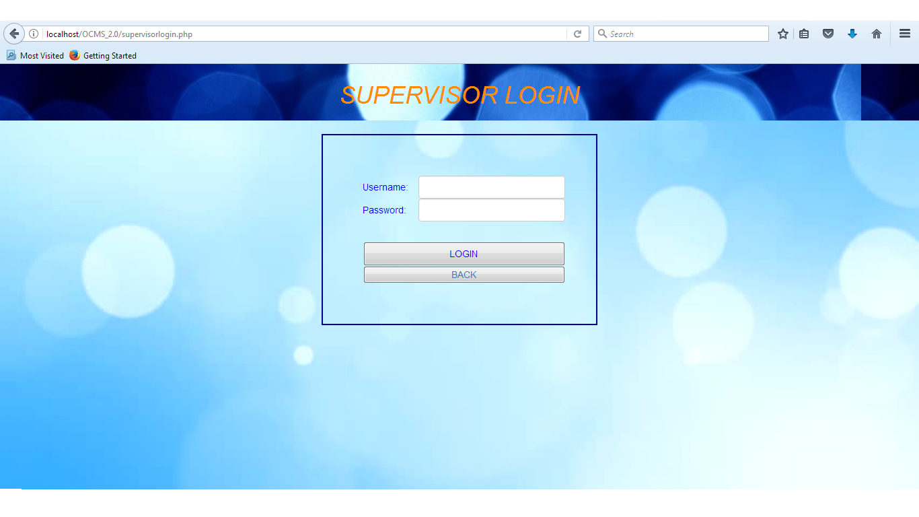
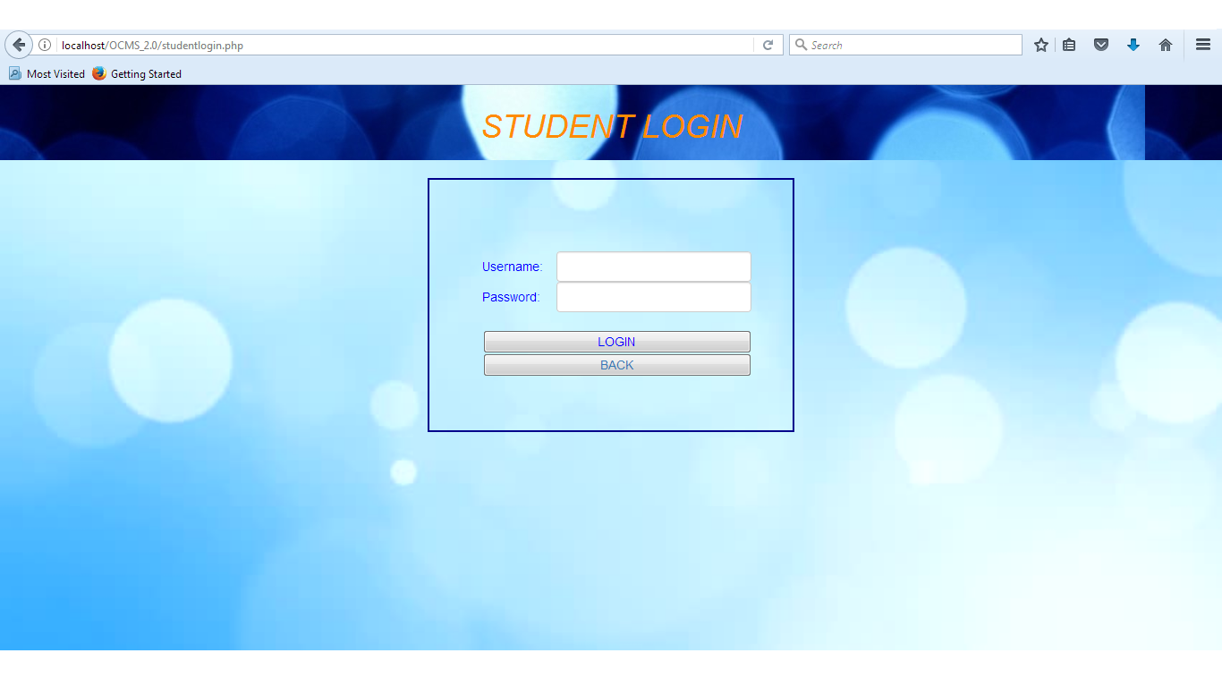

Slide 12
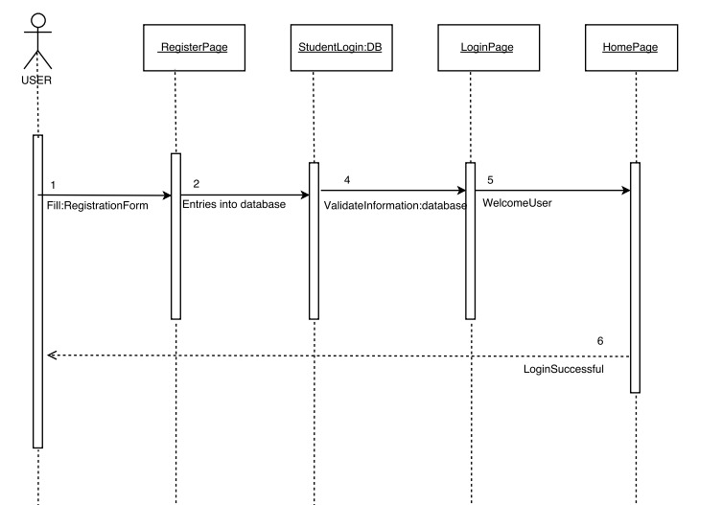
Sequence Diagram #1

Slide 13
User Story #2
As a Student/Supervisor, I would like to view my profile retrieved from the databases and upload a picture, so that I can see it on my profile page.
The database (phpmyadmin) has a database named user_login_system which has a student table in it. All the entries will be entered into this table.
The MySQL query will fetch the data from the database table and will display onto the profile page.
There is an option for user to select a image from the computer and upload it as their profile picture.
Notes:
20 seconds
The tile of user story
Please present and show the complexity of your work, code, algorithms, and technical challenges and technologies you have used. (you could use screenshot if you want. Visual presentations are better than text presentation) - Go into the details of the most important/significant tasks using bullet lists or visual graphs or state chart diagram - Demo using screenshots or GIF (in another separate page if required)
Sequence Diagram for this user story is optional

Slide 14
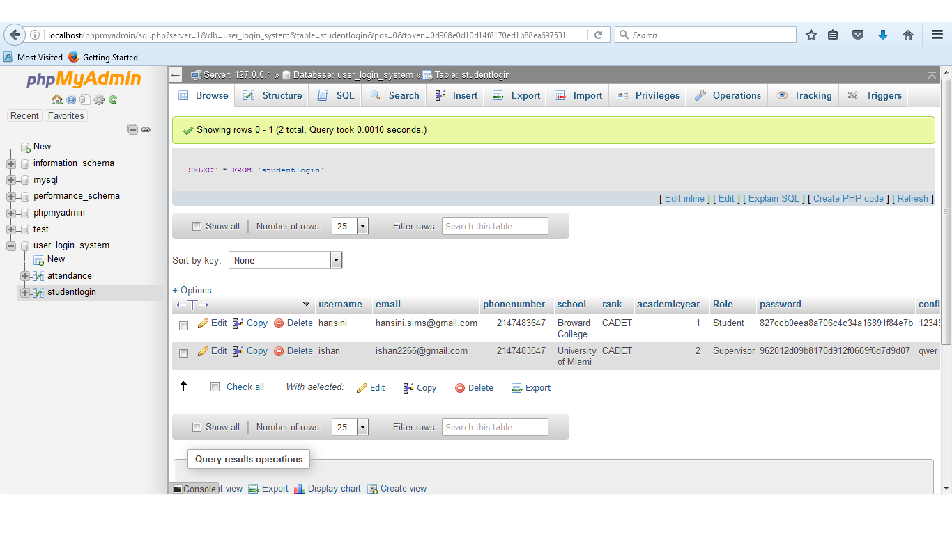

Slide 15
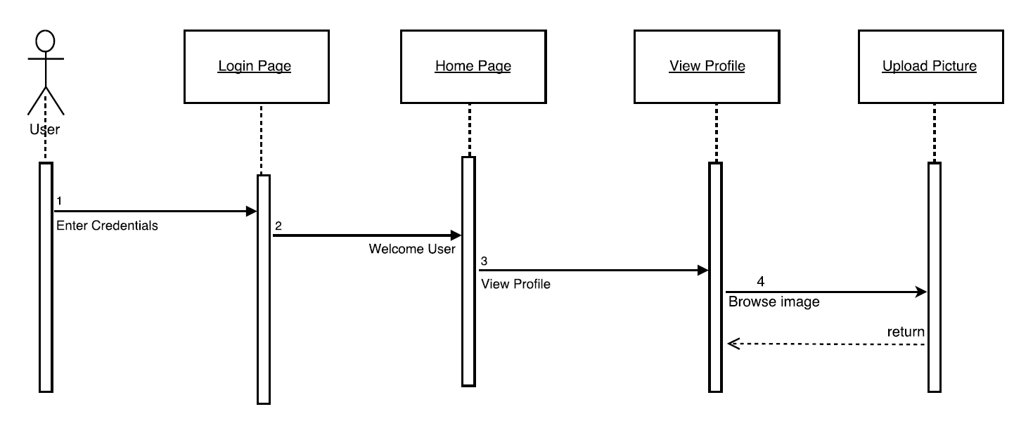
Sequence Diagram #2

Slide 16
User Story #3
As a Student, I would like to mark my attendance with name, date, time and IP address, so that the supervisor would know that I was present during the training.
The student should be registered and then login with student details.
The student can view his/her profile and then can mark the attendance in the attendance sheet.
Notes:
20 seconds
The tile of user story
Please present and show the complexity of your work, code, algorithms, and technical challenges and technologies you have used. (you could use screenshot if you want. Visual presentations are better than text presentation) - Go into the details of the most important/significant tasks using bullet lists or visual graphs or state chart diagram - Demo using screenshots or GIF (in another separate page if required)
Sequence Diagram for this user story is optional

Slide 18
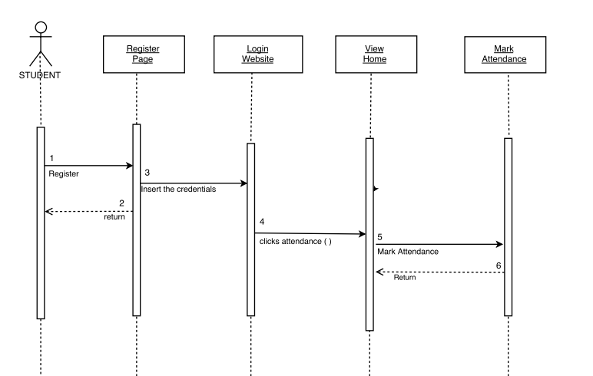
Sequence Diagram #3

Slide 19
User Story #4
As a Supervisor, I would like to view the attendance with name, date, time and IP address of the students who were present so that I know who all attended the training.
The supervisor should be registered and then login with supervisor details.
The supervisor can view his/her profile and can also view the attendance of the students with name, date, time and IP address.
Notes:
20 seconds
The tile of user story
Please present and show the complexity of your work, code, algorithms, and technical challenges and technologies you have used. (you could use screenshot if you want. Visual presentations are better than text presentation) - Go into the details of the most important/significant tasks using bullet lists or visual graphs or state chart diagram - Demo using screenshots or GIF (in another separate page if required)
Sequence Diagram for this user story is optional

Slide 20
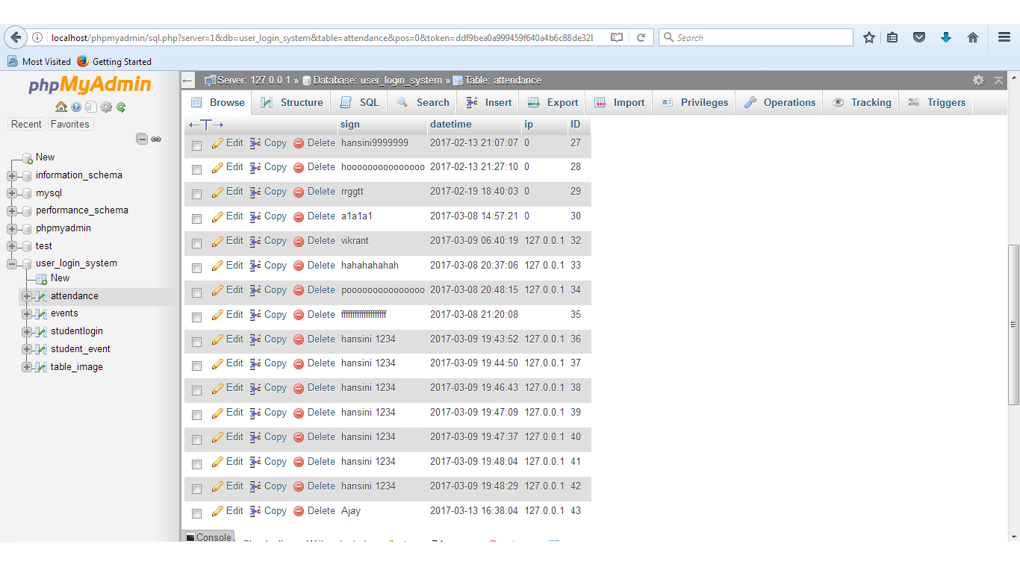

Slide 21
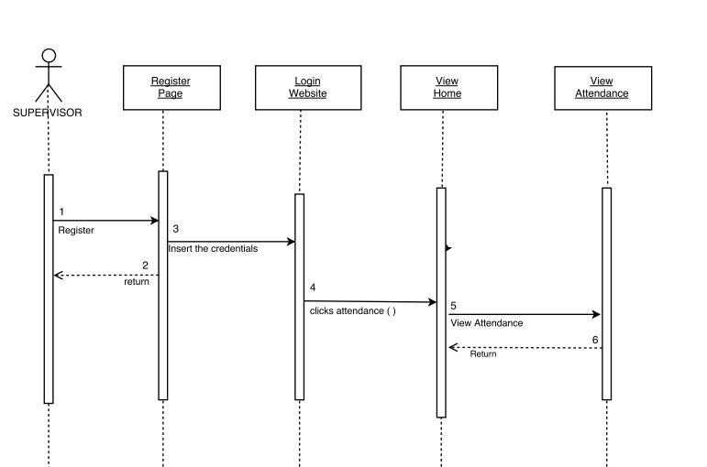
Sequence Diagram #4

Slide 22
User Story #5
As a Supervisor, I would like to create new events so that the students can view and join them. Also I would like to view the list of students enrolled in the event.
Supervisor can create the events by giving event description, name, title and time.
Students can join them by clicking on “Join event” button.
Notes:
20 seconds
The tile of user story
Please present and show the complexity of your work, code, algorithms, and technical challenges and technologies you have used. (you could use screenshot if you want. Visual presentations are better than text presentation) - Go into the details of the most important/significant tasks using bullet lists or visual graphs or state chart diagram - Demo using screenshots or GIF (in another separate page if required)
Sequence Diagram for this user story is optional

Slide 23
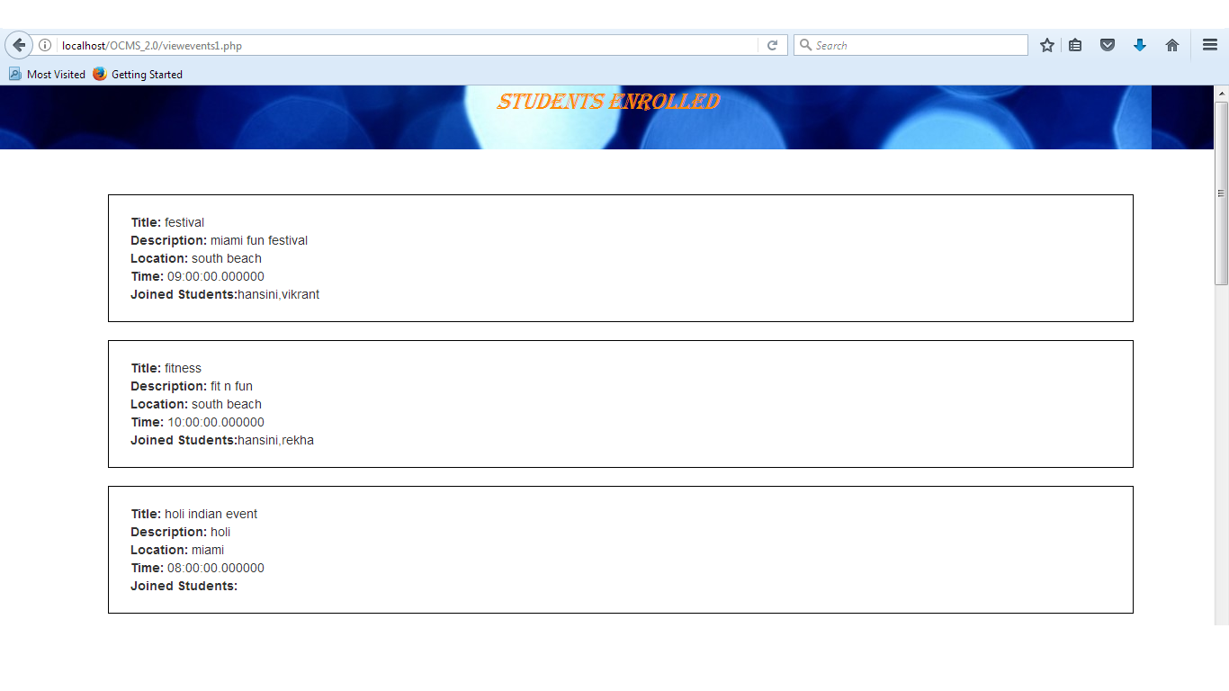

Slide 24
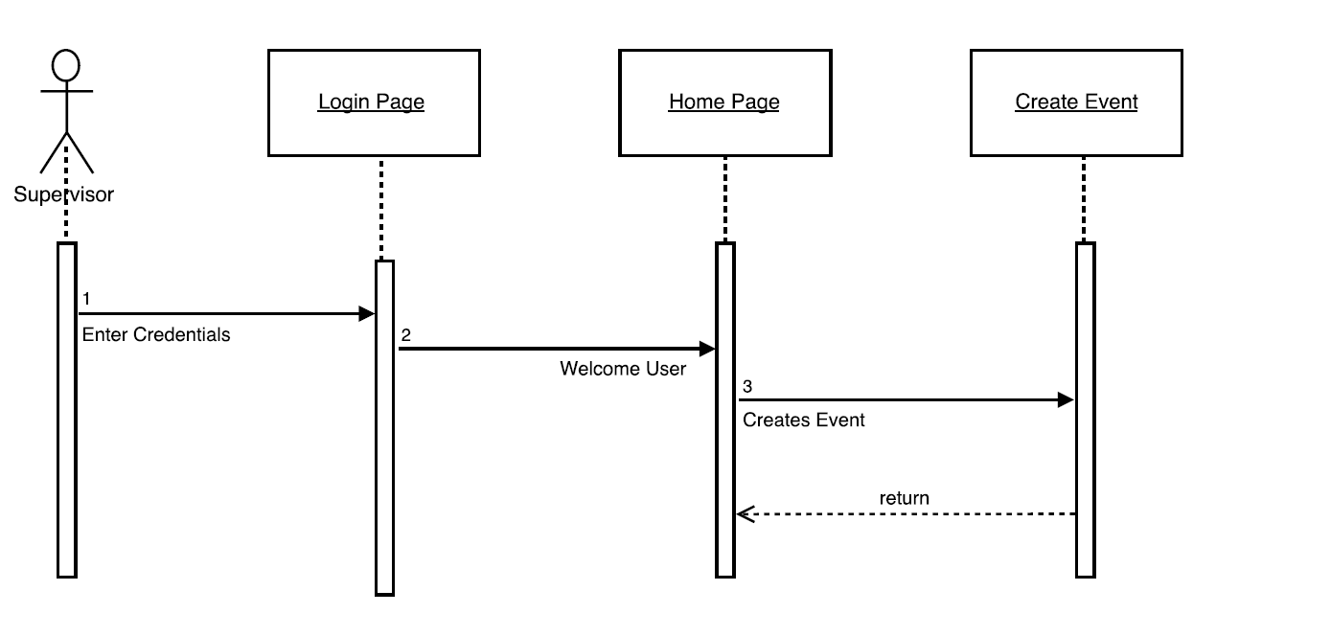
Sequence Diagram #5

Slide 25
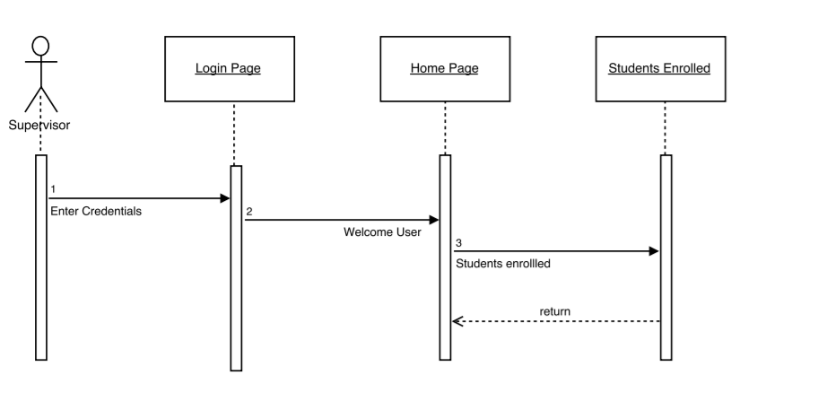

Slide 26
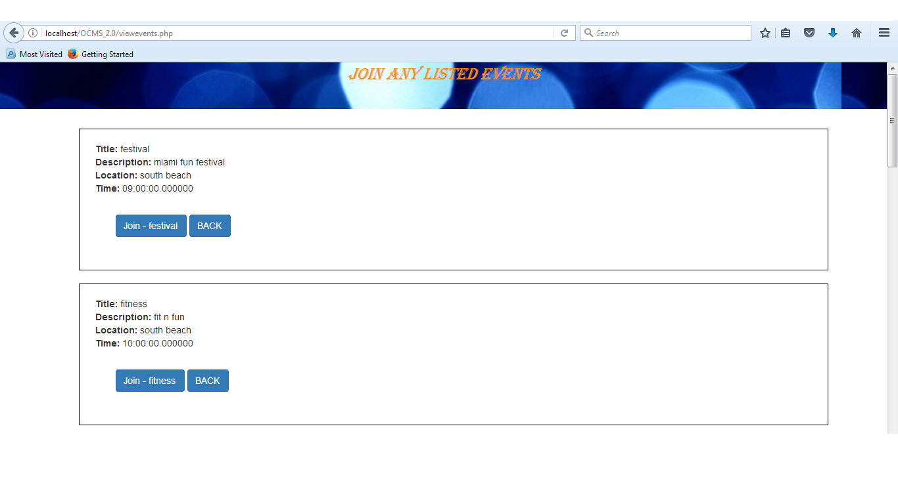
User Story #6
As a Student, I would like to view the events and join them, so that the supervisor will know that I have joined the particular event.
Student can view the events by clicking on “Current Events”
Students can join them by clicking on “Join event” button.
Notes:
20 seconds
The tile of user story
Please present and show the complexity of your work, code, algorithms, and technical challenges and technologies you have used. (you could use screenshot if you want. Visual presentations are better than text presentation) - Go into the details of the most important/significant tasks using bullet lists or visual graphs or state chart diagram - Demo using screenshots or GIF (in another separate page if required)
Sequence Diagram for this user story is optional

Slide 27
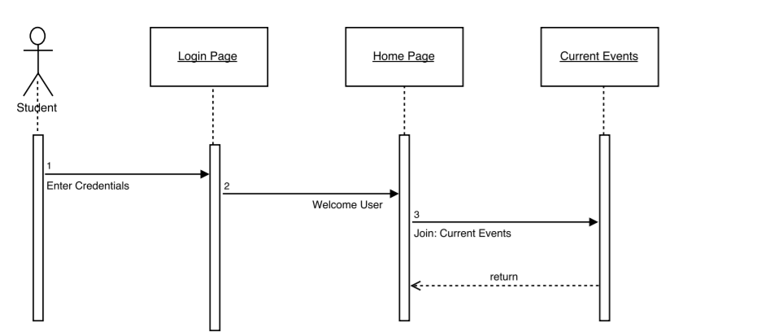
Sequence Diagram #6

Slide 28
Sunny Day Test Cases
Purpose:
To Successfully register, login, marking of attendance, creation for events and joining the events.
Preconditions:
Each user has to first register and then login.
Input:
A user has to give their personal details like name, email, phone number, password etc. to register and login.
Expected Result:
Student can login into the account and then can give the attendance by name, date, time and IP. Also can join the listed events.
Supervisor can see the attendance by login into the account and can also create the events and see the list of students joined for the events.
Both the user can upload their profile image.
Notes:
10 seconds
A description of verification process and Test Suites and Test Cases for one of the use cases.
1 One sunny day and one rainy day for the implemented use cases (one or more slides).
2 Automated test scripts for the implemented use cases (if any) (one or more slides).

Slide 29
Rainy Day Test Cases
Purpose:
Deployment of the application on AWS server with database connection.
Preconditions:
User can perform all the operations of register, login, attendance, events.
Input:
A user has to give their personal details like name, email, phone number, password etc. to register and login.
Expected Result:
The application is deployed on AWS server with this URL:ocms.us-east-2.elasticbeanstalk.com
But the error displays mysqli_connect error;
That means the functionality of database is not working properly with the application.
Notes:
10 seconds
A description of verification process and Test Suites and Test Cases for one of the use cases.
1 One sunny day and one rainy day for the implemented use cases (one or more slides).
2 Automated test scripts for the implemented use cases (if any) (one or more slides).

Slide 30




Summary
Ishan’s contribution to this project consisted of Displaying the event page on students account, Customizing the registration and login page, applying for an event and marking of the location.
Hansini’s contribution to this project includes of Redesigning of the application, Creating Event Page for supervisor, User Image, List of students enrolled for an event.
Contact Information:
Hansini Seth (hseth001@fiu.edu, +17866364901)
Ishan Shrivastava (ishri001@fiu.edu, +17866125729)
Notes:
10 seconds
Summarize your contribution, mention your effort for Scrum, Mingle, Github, Google Drive Documentation and minutes
Include your contact information
Ask if anyone has any questions for you.
Thank your audience

Slide 31


